Slide 1

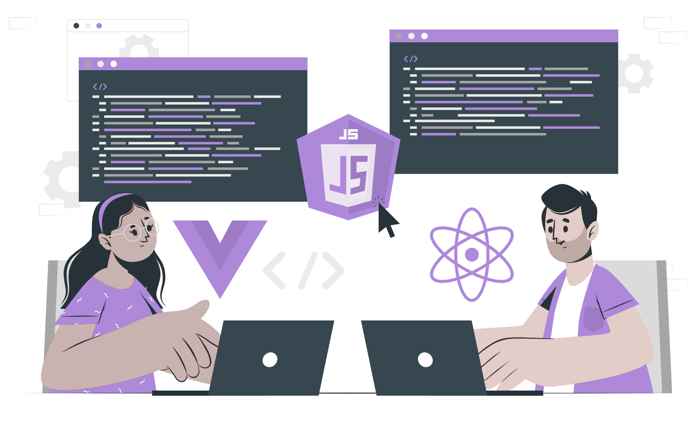
Intro to
Node JS
(Runtime, V8, Libuv)

Slide 2
What is Node JS?
Node.js is an open-source, cross-platform JavaScript runtime environment that enables developers to run JavaScript code on the server side.

Slide 3
Features of Node JS
Easy to use
Scalable
Speed
Packages
Strong Backend
Multi-platform
Maintainable

Slide 4
Applications of Node JS
Web applications
Real time chats
Data streaming
IoT applications
Complex SPA’s
Rest API server

Slide 5
How to Install Node JS?
Go to https://nodejs.org/
Download the installer for your operating system (Windows, macOS, or Linux)
Run the installer and follow the prompts to install Node.js
Verify installation by typing "node -v" in terminal/ command prompt, which will display the version of Node.js installed.

Slide 6
What is Runtime?
Runtime is a piece of code that implements portions of a programming language's execution model. Doing this, allows the program to interact with the computing resources it needs to work. Runtimes are often integral parts of the programming language and don't need to be installed separately.

Slide 7
Runtime in JavaScript
In JavaScript, runtime refers to the period during which a JavaScript program is executed by a JavaScript engine. When a JavaScript program is loaded into a web page or runs using a command-line tool, the JavaScript engine starts to execute the code. The JavaScript engine follows a set of rules, known as the JavaScript specification, to interpret and execute the code.

Slide 8
How does JavaScript Runtime works?
JavaScript runtime works by interpreting and executing JavaScript code. When a JavaScript program is loaded into a web page or runs using a command-line tool, the JavaScript engine starts to execute the code. The engine follows a set of rules, known as the JavaScript specification, to interpret and execute the code.

Slide 9
What is V8?
V8 is an open-source JavaScript engine developed by Google and used in the Google Chrome browser. It's responsible for executing JavaScript code within the browser, parsing and compiling JavaScript code into machine code for faster execution.

Slide 10
Key features of V8
Written in C++
Dynamic Optimization
Heap Allocation
Garbage Collection
Modern JavaScript Features
Open-Source

Slide 11
What is Libuv?
ibuv is a cross-platform library for asynchronous I/O, developed for use in Node.js. It provides a uniform API for working with asynchronous I/O operations, such as file system operations, network communication, and timers.

Slide 12
Key features of Libuv
Cross-Platform
Asynchronous I/O
Event Loop
Thread Pool
Process Management
Open-Source

Slide 13
THANK YOU

